Slide 1
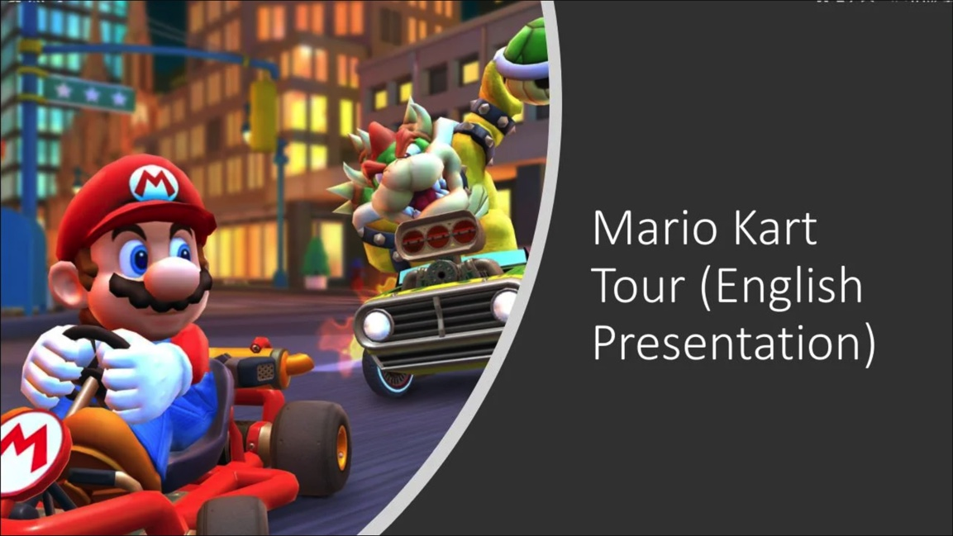
MSU Data Analytics Bootcamp
June 2022 Cohort
Final Project
G7 – “The Blue Power Shells”
FKA “The-Travel-Agents”
Kelly McQuillan
Jon May
Jordan White
Erika Wilson
June 1, 2022
Notes:
Erika

Slide 2
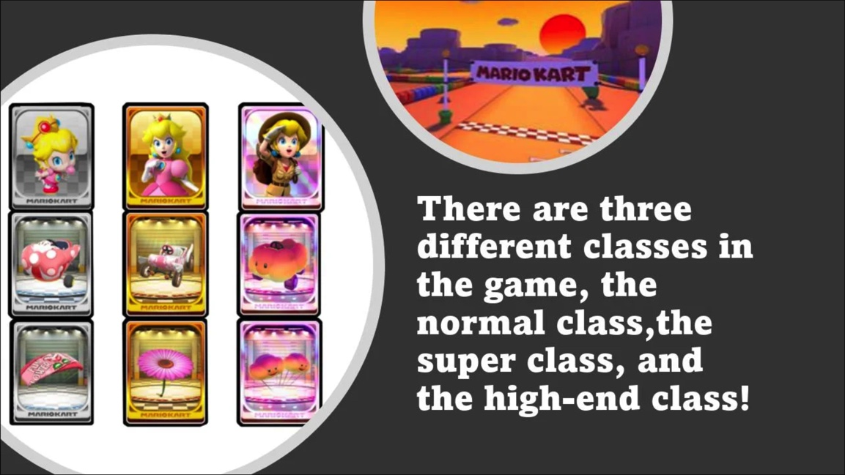
Agenda
Project Intro
Hypothesis
Process
Demo
Gotchas
Questions
Notes:
Erika

Slide 3
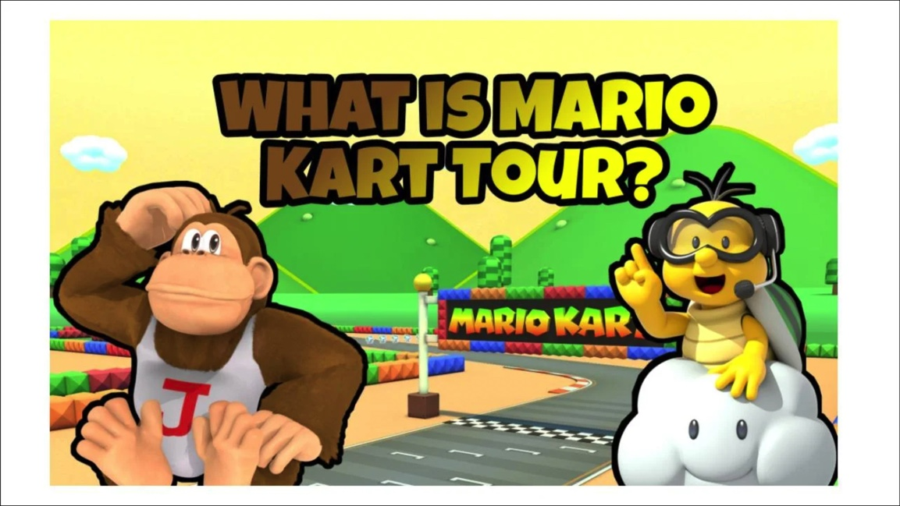
Notes:
Jon

Slide 4
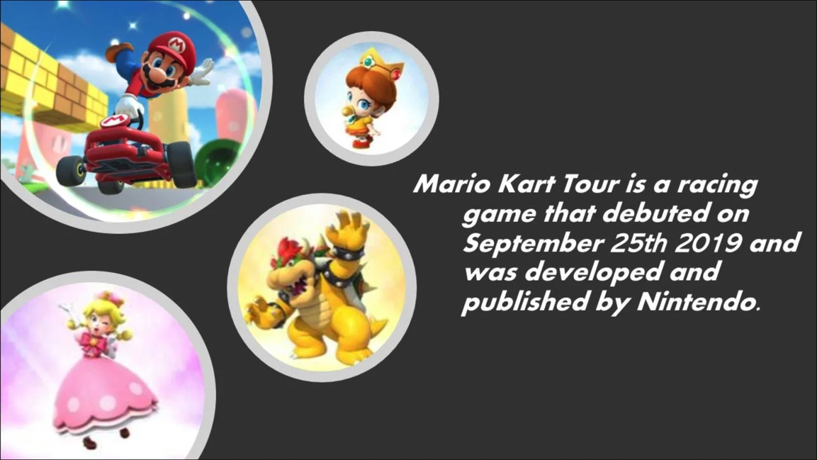
To predict a courses’ best performing character.
Notes:
Kelly

Slide 5
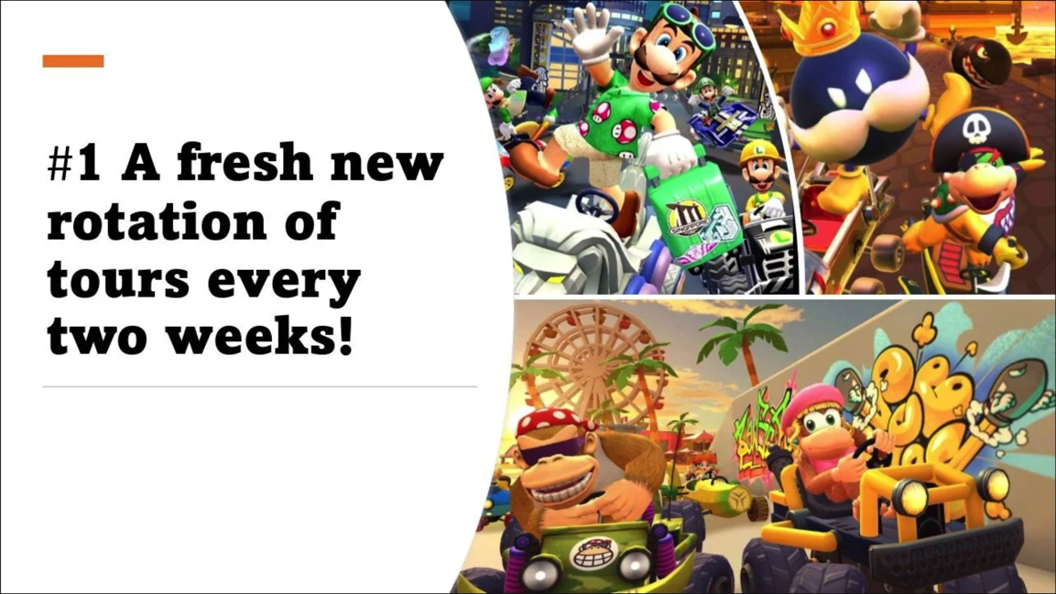
Process
Dataset
2. Database
3. Models
4. Website
Notes:
All

Slide 6
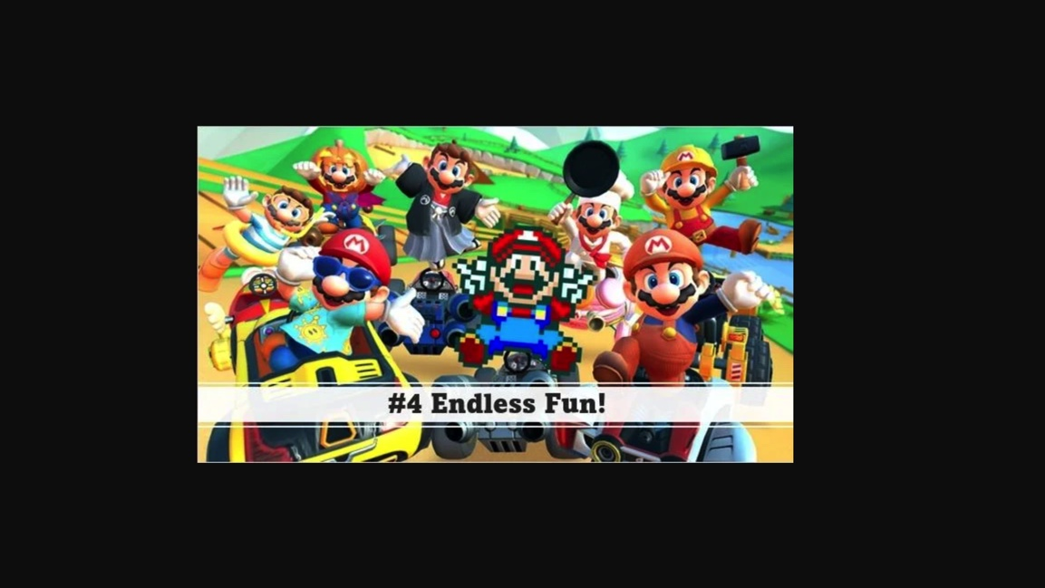
Machine Learning Models

Slide 7
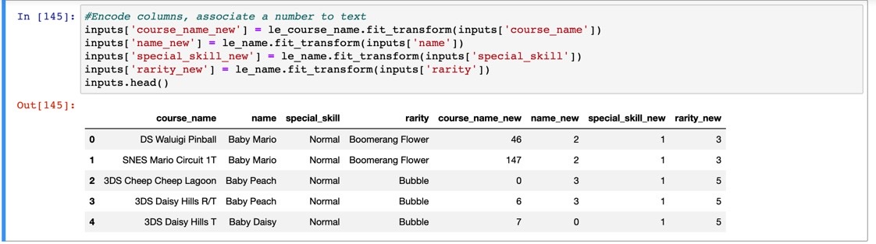
Data
Notes:
Course Name = DS Waluigi Pinball
Character: Baby Mario
Special Skill: Normal
Rarity: Boomerang Flower

Slide 8
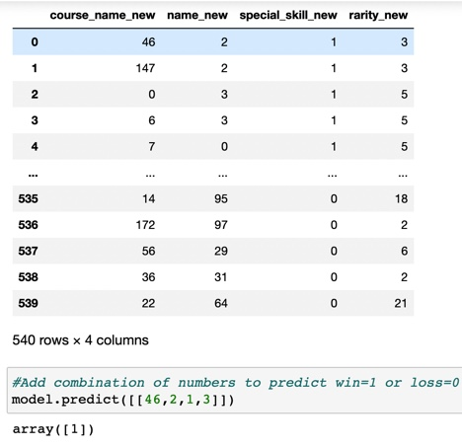
Decision
Tree
Results

Slide 9
If I select
Course Name = DS Waluigi Pinball (46)
Character =
Baby Mario (2)
Special Skill = Normal (1)
Rarity = Boomerang Flower (3)
WINNER!!!
Notes:
All

Slide 10
Data
Notes:
Course Name = DS Waluigi Pinball
Character: Baby Mario
Special Skill: Normal
Rarity: Boomerang Flower

Slide 11
If I select
Course Name = Vancouver Velocity R [172]
Character =
Wario (Hiker) [97]
Special Skill = High-End [0]
Rarity =
Bob-omb Cannon [2]
LOSER!!!
Notes:
All

Slide 12
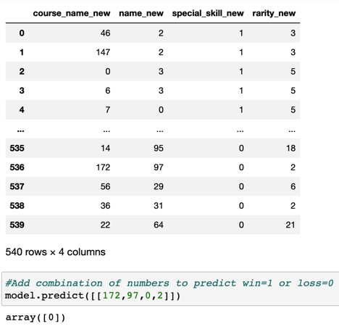
Decision
Tree
Results

Slide 13
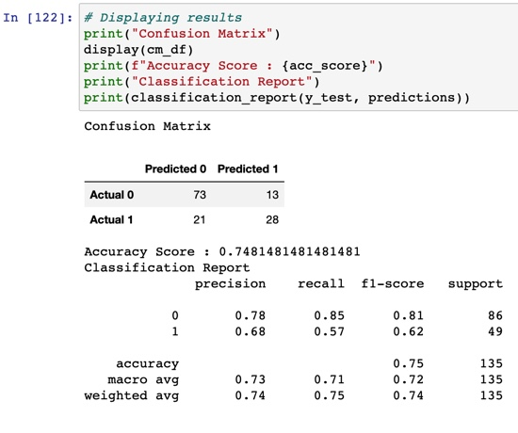
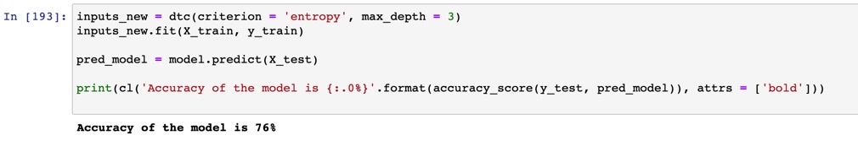
Confusion Matrix & Model Accuracy

Slide 14

Demo

Slide 15
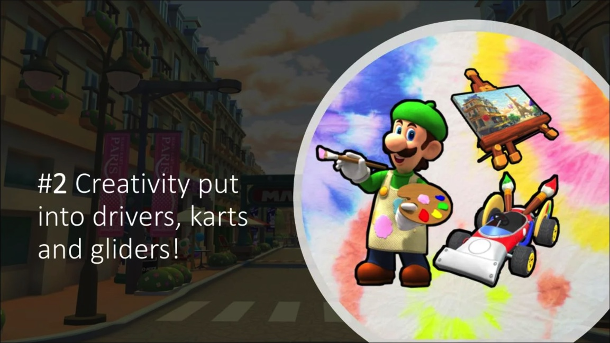
Gotchas
Appropriate data-set
Data cleaning
Model selection
Data cleaning
Model selection
DATA CLEANING!!!!
Notes:
Jordan

Slide 16

What questions do you have?

Slide 17
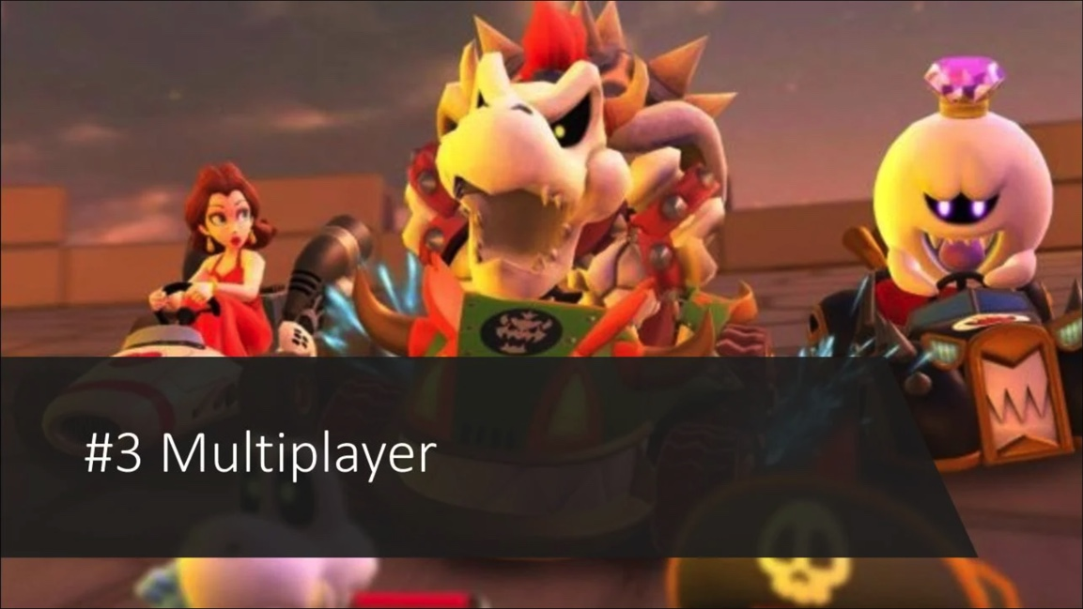
Thank you!!!

Slide 18
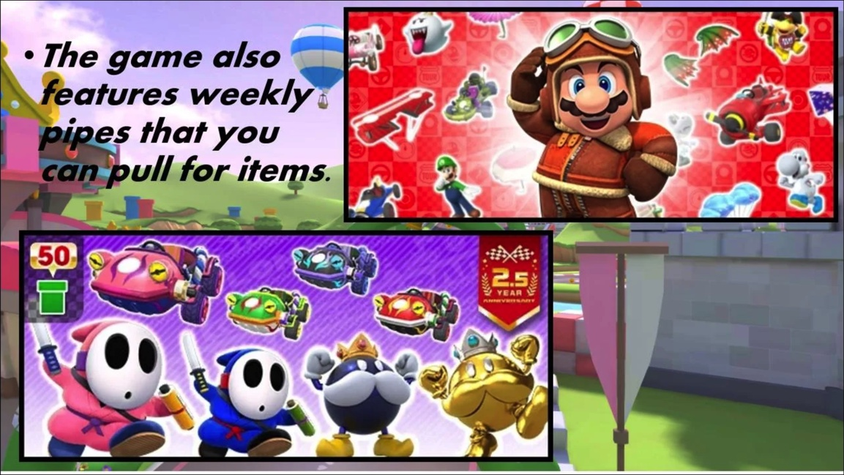
Data Source:
https://mario-kart-tour-api.herokuapp.com/
GitHub:
https://github.com/JordanWhite21/TheTravelAgents

